Slide 1
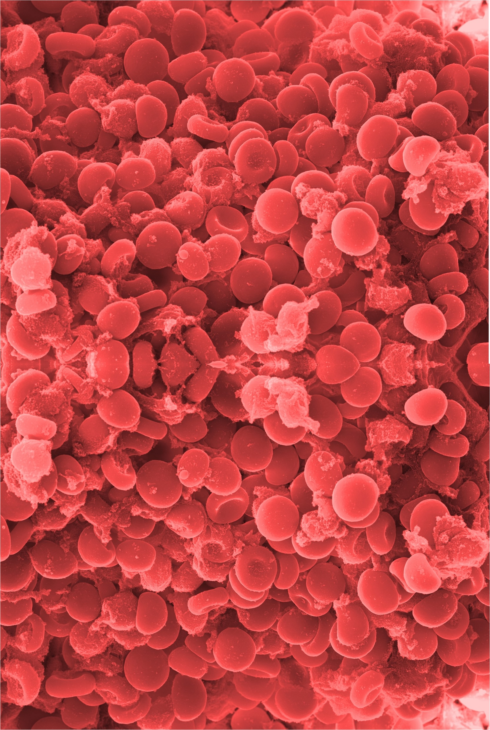
???????????????????????????????????????????????
64
Department of Anaesthesia, University Hospital Galway
Introduction
???????????????????.
19 hospitals with cardiac arrest teams do not use 2222 at all (27.9%, see Figure 1). Of public hospitals, 78.4% use 2222 as a cardiac arrest call number, compared with 52.9% of private hospitals (see Figure 2). Overall, 18 different cardiac arrest numbers and various button systems are in use (see Table 1).
Discussion
5f4fsadfdsafojdsafoihdsaf;;;ihihfdfhdsafdsdsf
Method
?????????????????????????????????????????????????????????????
Conclusion
?????????????????????
2222 | 5300 | 5999
221 | 4444 | 222
5555 | 7777 | 555
7222 | *22 | 3333
2520 | 20699 | 77 0 008
110101 | 22555 | specific number from every phone
Results
In total, 68 hospitals with cardiac arrest teams were identified. 49 (72.1%) of these hospitals use 2222 as a cardiac arrest number, including 9
hospitals which also use alternative systems.
References
European Board of Anaesthesiology. The European Board of Anaesthesiology recommends a standard Cardiac Arrest call telephone number in European hospitals. (2015).
Whitaker, D. K. Establishing a standard ‘Cardiac Arrest Call’ telephone number for all hospitals in Europe—2222. Resuscitation 105, e25 (2016).
Table 1: Cardiac arrest call numbers in operation in Ireland

